Slide 1
Deep Learning for Video Depth Estimation from Defocus
Kevin Galim
Technische Universität München, Department of Informatics
Maxim Maximov
Prof. Dr. Laura Leal-Taixé
Notes:
Hello and welcome to my master thesis presentation about "Deep Learning for Video Depth Estimation from Defocus"

Slide 2
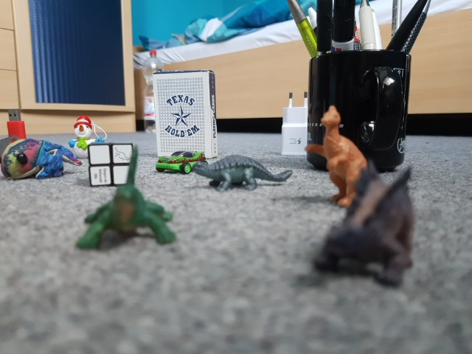
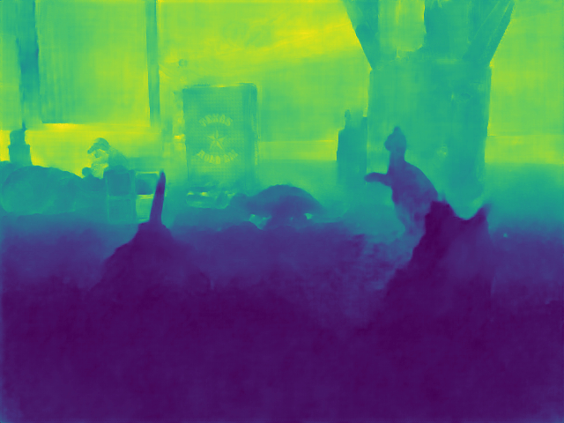
Depth Prediction
Images only supply 2D information
Depth essential for 3D understanding
Applications
Robotics
Refocusing
Augmented Reality
Image
Estimated
Depth
Notes:
As you know images only give a 2D impression of the 3D world. So when a machine wants to infer from the 3D structure of the real world this is not really sufficient.
That's why it is important to also know how far away each pixel is from the camera in order to get a 3D understanding of the scene. A map which gives the distance from each pixel to the camera is thereby called a depth map. Combining the RGB image and its depth gives the machine way better capabilities to analyze the displayed scene.
In the end there are lots of applications where knowing the depth is essential to properly execute the desired task. Few of them are robotics, changing the focus of an image after it has been recorded and Augmented reality

Slide 3
Motivation: Video Depth from Focus
Video Depth-From-Defocus (Hyeongwoo et al.)
Similar aim: video depth from defocus
Complex multi-step variational approach
Limited regarding the amount of motion which can be compensated
Deep Depth From Focus (Hazırbaş et al.)
Deep learning approach
Limited to static scenes
Limited generalization
Notes:
Our motivation to predict depth from videos in the end basically lies in the work of two other projects. Both approaches input a stack of images where the focus distance is varying. Using the varying defocus blur in the images it is then possible to make assumptions about the distance of those objects.
The first is Video Depth-From-Defocus by Hyeongwoo. Their goal is also to predict depth from videos. They used a complex mutli-step variational approach to realize their idea but are limited in the end on how much motion which is happening in the video can be compensated.
On the other hand we have Deep Depth From Focus by our chair which uses a deep learning approach to infer depth from static scenes. However their approach struggled to generalize to scenarios which were not presented in the training set in our tests.

Slide 4
Problem Statement
Input: RGB sequence
Varying focus distance
Static or under the influence of motion
Goal: Predict depth
Based on the amount of defocus
Using a deep learning approach
Notes:
We want to combine both worlds and implement a deep learning approach for estimating depth from dynamic video sequences. Our input should thereby be a RGB sequence where the focus distance is varying in each frame. The input can thereby be eiter static or dynamic. The goal is then to predict depth using the defocus blur.

Slide 5
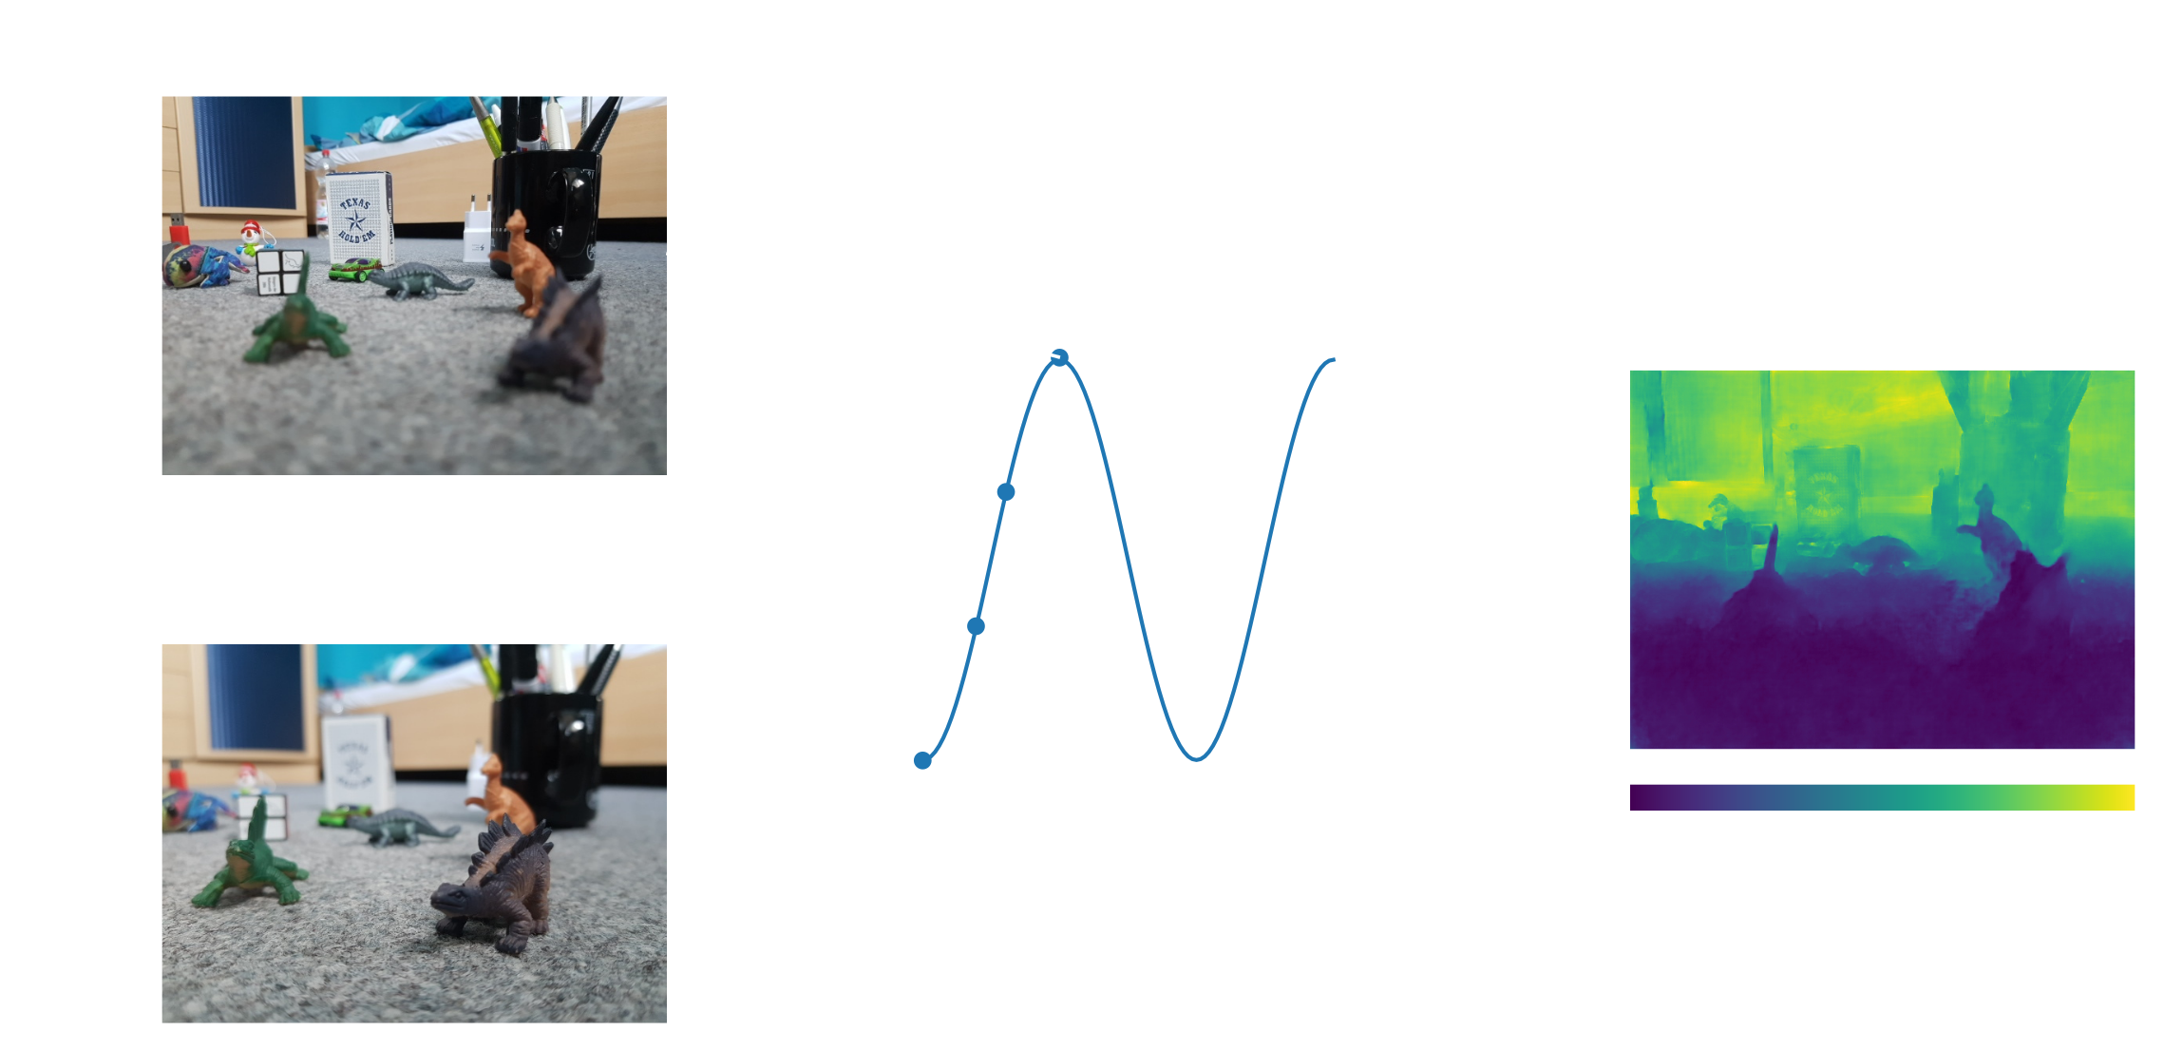
Concept
Notes:
Several focus stacks in sequence form a video

Slide 6
Key Contributions
CNN architectures for depth from focus prediction
Generalization for various settings (static and dynamic)
Robust to scene movement
Real-World dataset
Android phone and RGB-D sensor
Calibration and synchronization
Synthetic dataset
Fully automatic creation of large datasets at little expanse
Random scene generation

Slide 7
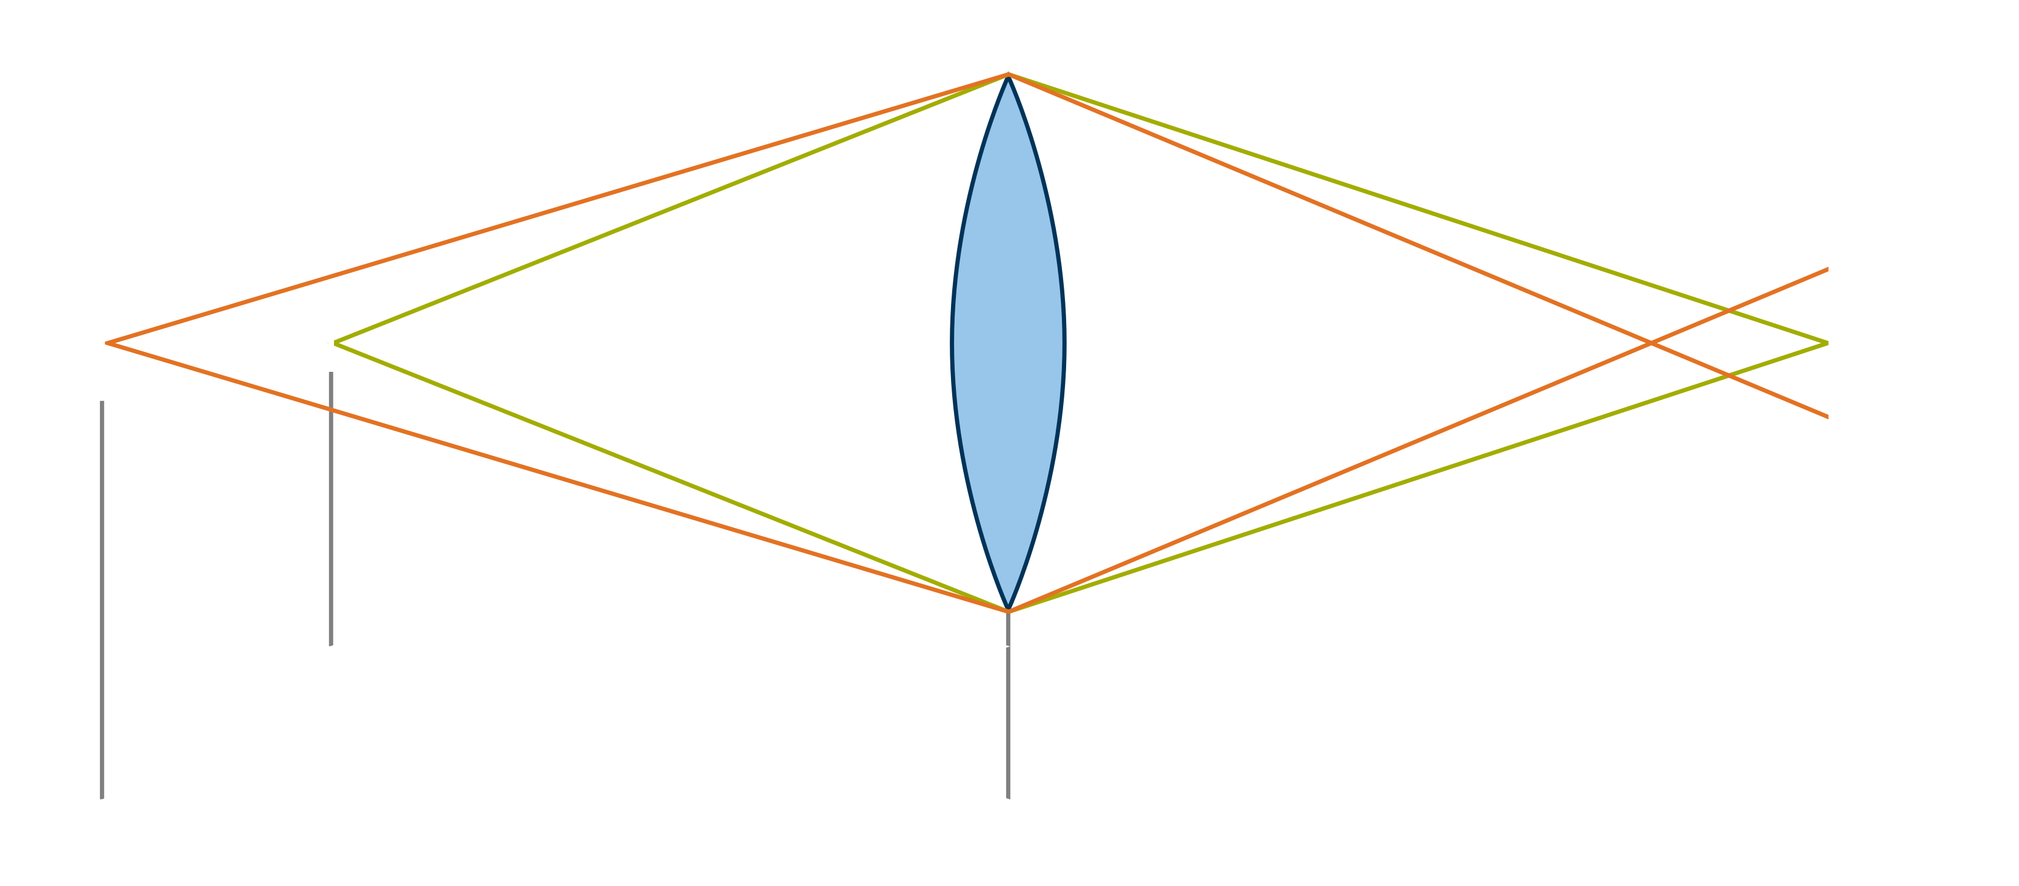
Circle of Confusion (CoC)
Notes:
CoC gives the amount of defocus of one point
Point in scene -> point on image if exactly the focus distance apart from the lens (perfect focus)
Otherwise point will blur to circle, the diameter is given by the circle of confusion
Depth from focus builds on this relation
Measure for how much out focus a point is
Related to depth, the more the object is off the focus distance the larger is the CoC

Slide 8
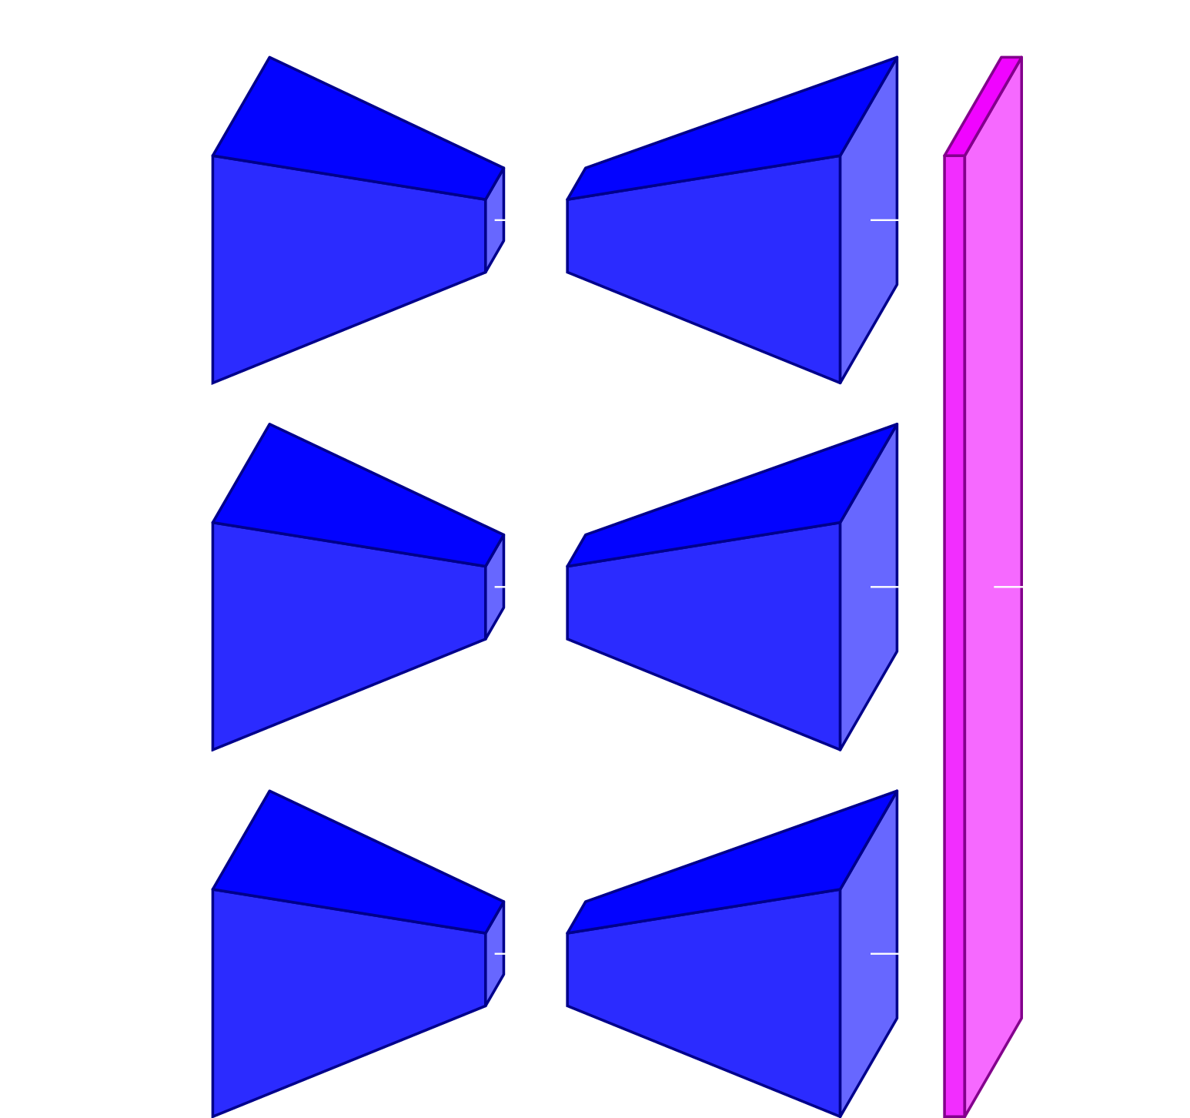
Related Work: Deep Depth From Focus (Hazırbaş et al.)
DDFFNet
VGG16 based encoder-decoder
Static focus stacks
Frames are processes independently and finally scored
Generalization problems
Notes:
Now lets review the related work to our approach. First of all we'll look at the Deep Depth from Focus in more detail. The key contribution was thereby the CNN DDFFNet which is a VGG16 based encoder-decoder. The input thereby are static focus stacks. The network basically processed each image of the stack independently. Only in the end there is a final 1x1 convolution layer which concatenates all individual outputs and reduces them to one. In our experiments this network struggled to generalize properly.

Slide 9
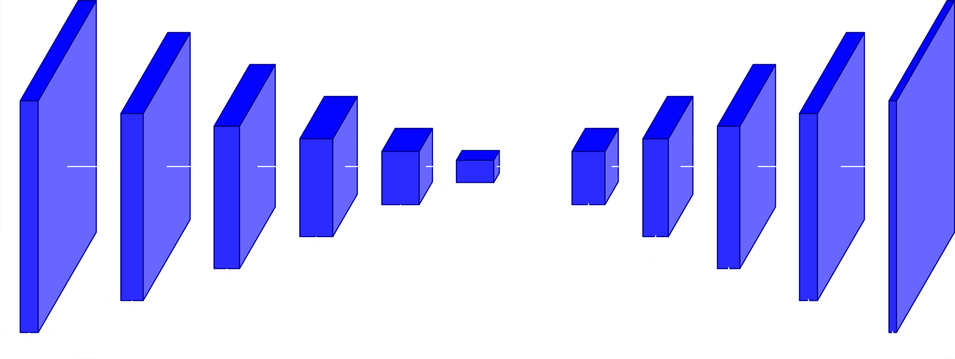
Related Work: Interactive Reconstruction (Chaitanya et al.)
Recurrent Autoencoder
Encoder-Decoder
Recurrent blocks having skip connections to themselves
Similar to an RNN but is fully convolutional
Notes:
so called recurrent blocks have skip connections to themselves
forward and concatenate the block output from the previous input
last block output forms hidden state
indicated by the circular arrows in the picture on the right

Slide 10
Depth Prediction Approach
Architectures
LSTM-DDFF using the DDFF in joint with an LSTM
Modified recurrent autoencoder
Batch normalization
More feature channels
Transposed convolution instead of upsampling
Extension: Additional decoder for CoC
Produce one depth map per focus stack
Notes:
Now we are going into more detail about our approach. We are basically proposing 2 different CNN architectures. The first is the LSTM-DDFF which combines the DDFF with an LSTM. The other one is a modification of the Recurrent Autoencoder.
Additionally we introduce one further general extension which adds a second decoder to an encoder-decoder system for CoC for additional supervision. In the end we are going to produce a single depth map per focus stack.

Slide 11
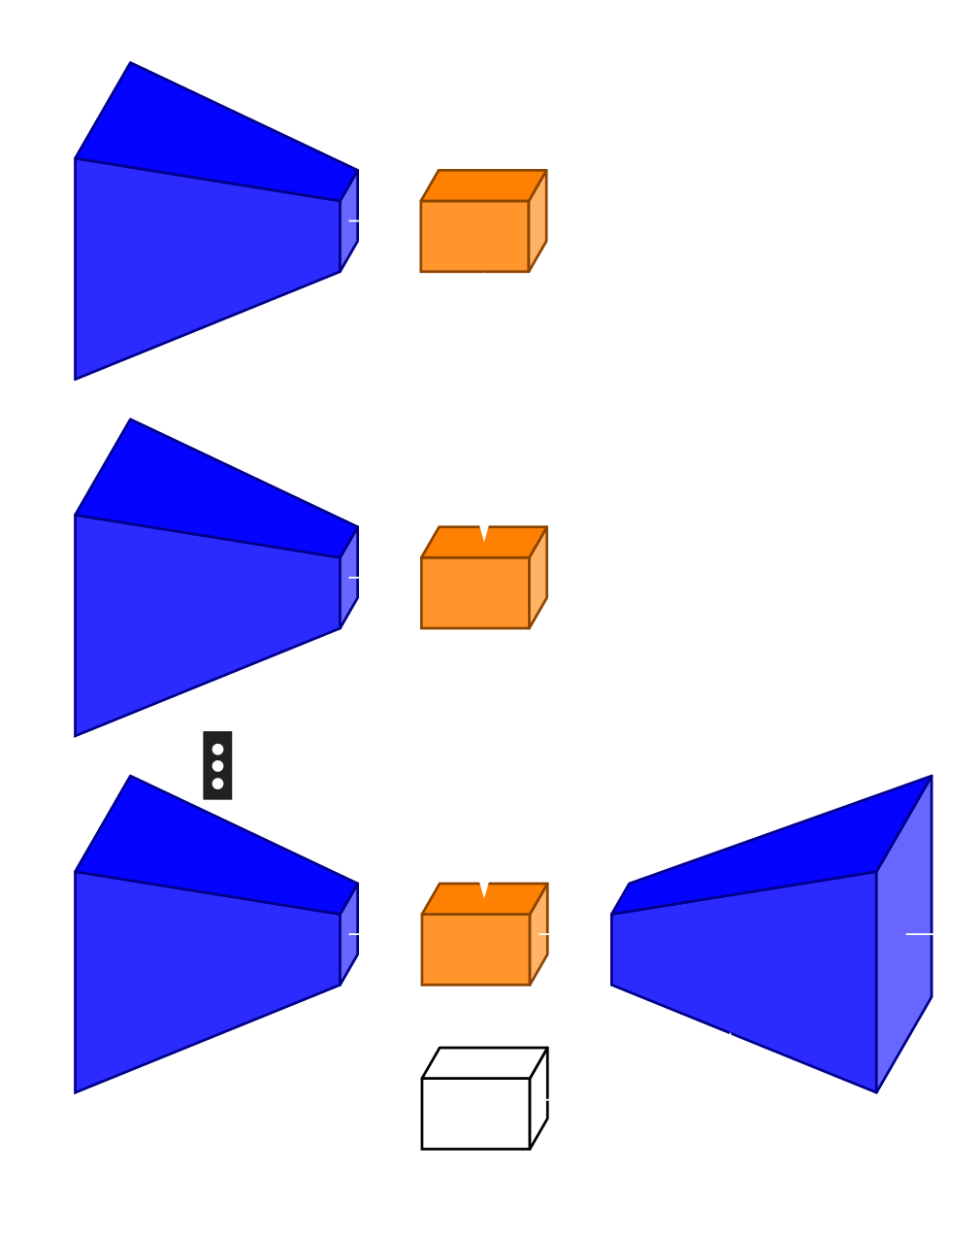
LSTM-DDFF
DDFF lacks sequential understanding
Recurrent Module
No fully connected layers but long sequence of flattened feature maps
Double layered LSTM
Skip Module: Convolution
Notes:
The LSTM-DDFF builds on the fact that the original DDFF lacks proper sequential understanding. Thus we want to extend it with an LSTM which we insert in the form of a recurrent module in between the encoder and the decoder. Besides the LSTM the recurrent module also performs flattening and dimension reduction to suit the LSTM. The encoding from each input thereby gets successively fed to the recurrent module whereas only for the last input the decoder is applied.
We also have to treat the skip connections since there are multiple encoder applications but only one decoder. For that we either only consider the output of the last encoder or take the input from all encoders and score it using a 1x1 convoluion.

Slide 12
Extension: CoC Supervision
Add a second decoder to an encoder-decoder system for COC
Additional supervision for depth from focus
Circle of confusion useful for different applications
Notes:
Now to our extension: the CoC supervision. Here we will incorporate the role of the CoC as an explicit compoment in our existing encoder-decoder systems. Thereby we add an additional decoder which is supervised to ouput a CoC prediction for each pixel. This additional supervision should help the networks to focus on the CoC clue to infer the depth.

Slide 13
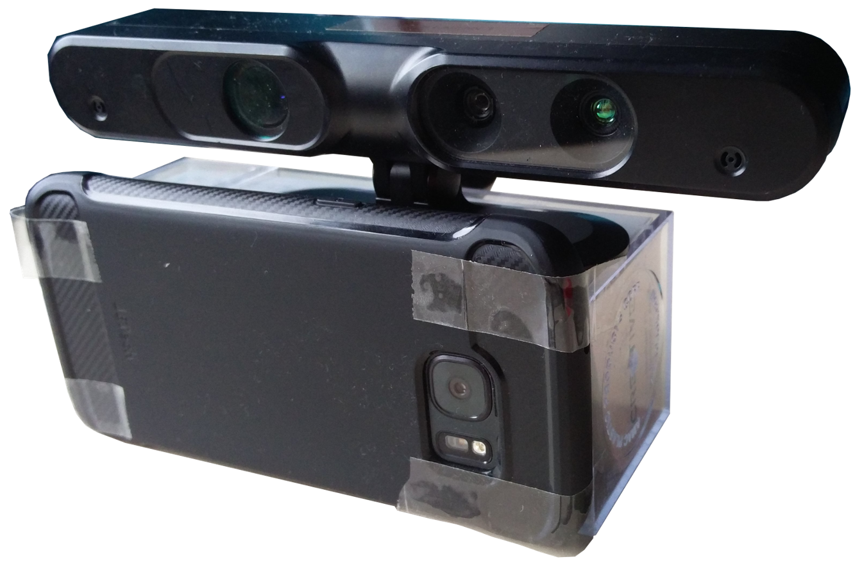
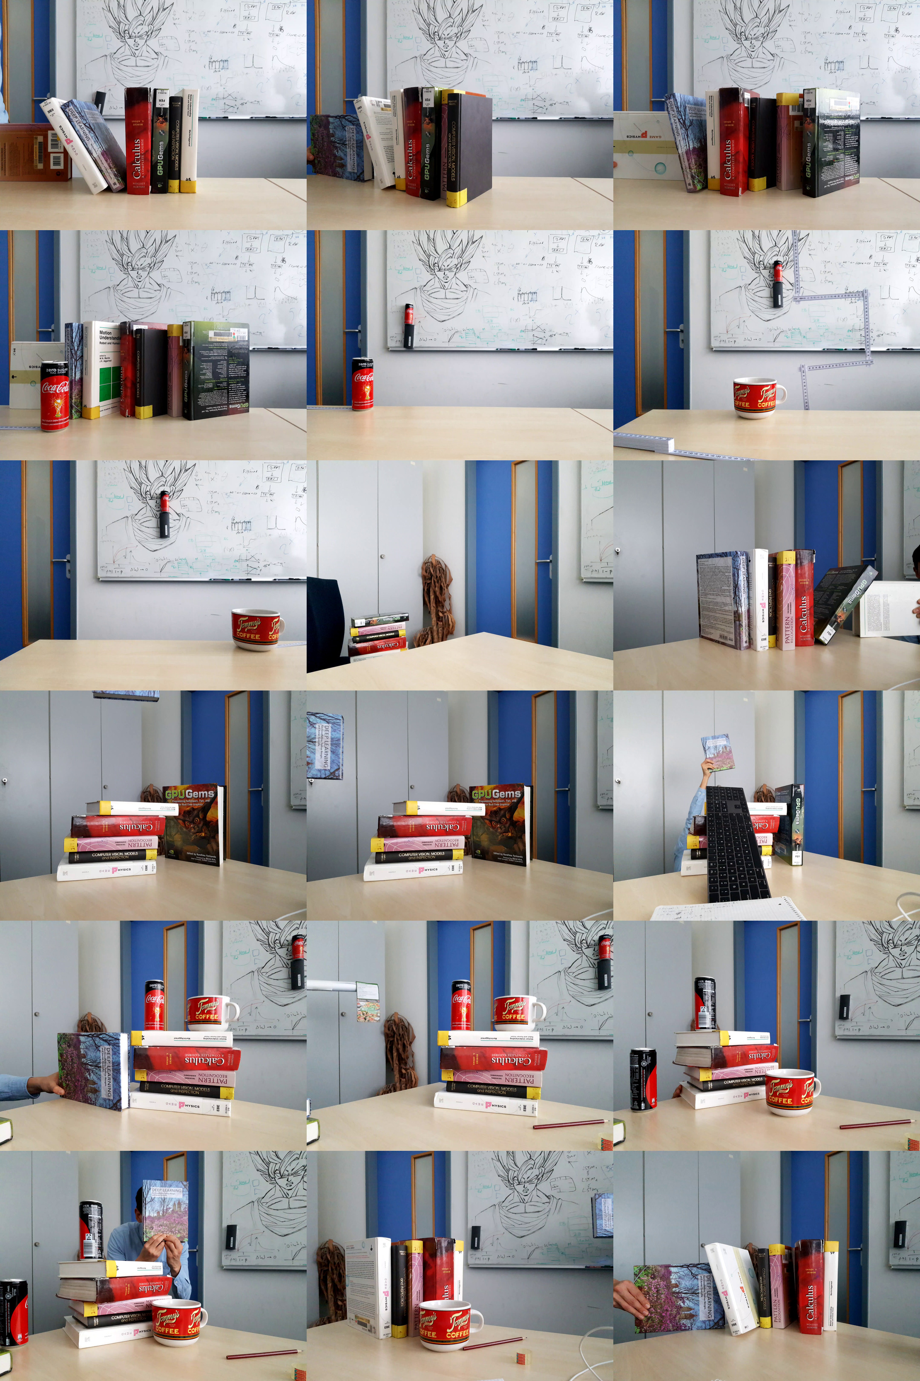
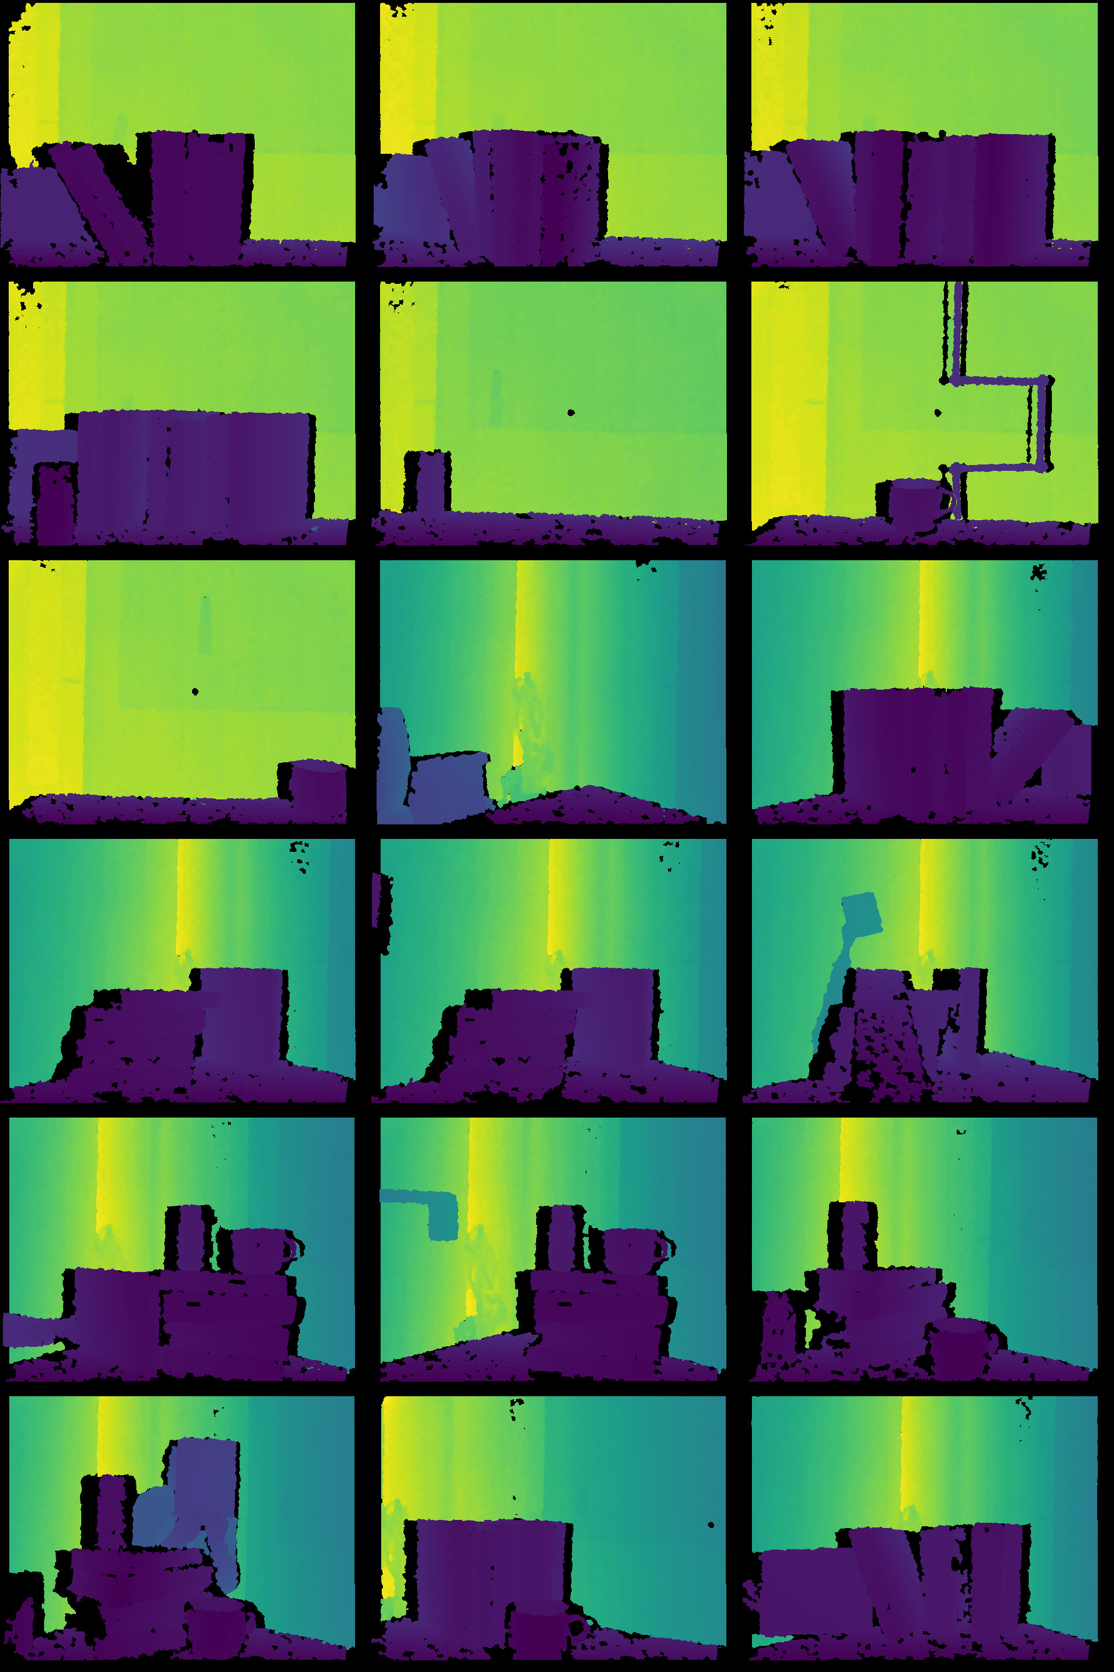
Real-World Dataset
Samsung Galaxy S7 color recording via an Android application
Asus Xtion RGB-D sensor for depth ground truth
Calibration between Android and RGB-D color sensor
Frame association using common clock
Limitations: hardware and time
Notes:
Additionally we recorded a real world dataset with depth ground truth. We used a Samsung Galaxy S7 smartphone together with an application by us. This application automatically changes the focus distance while recording a video in a way to exacty meets the requirements of our CNNs. For the depth ground truth we used the Asus Xtion RGB-D depth sensor. We calibrated the RGB sensors of both cameras to later be able to align the color and depth frames. We associate common color and depth frames by agreeing on a common clock.

Slide 14
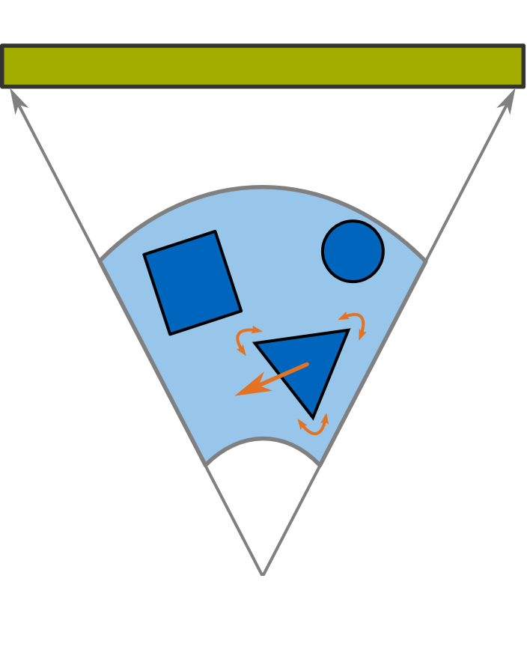
Synthetic Dataset
CoC domain independent
Blender for virtual scene rendering
Physical lens model
Perfect depth ground truth
Randomization
Objects, textures and light
Transformations and animations
Train-test split object/texture pool
Notes:
Thats why we eventually decided to create a training set synthetically. We build on the assumption that the CoC is domain independent meaning it does not depend on the actual objects or textures in the scenes. We thereby use the Blender 3D graphics program to render virtual scenes for us. The software implements a lens model similar to the real world meaning we can simulate arbitrary cameras. Another advantage is that we will get mathematically perfect depth ground truth at no expense. For creating a massive pool of scenes we will make use of randomization. We have a large dataset of 3D models and textures and will randomly select a subset for each scene. We will place objects randomly at a defined spawn range in front of the camera. Also we will select the light position randomly. Objects will be animated to move through space. To also create a synthetic test set we will reserve a part of our model and texture pool and only use it for rendering test sequences.

Slide 15
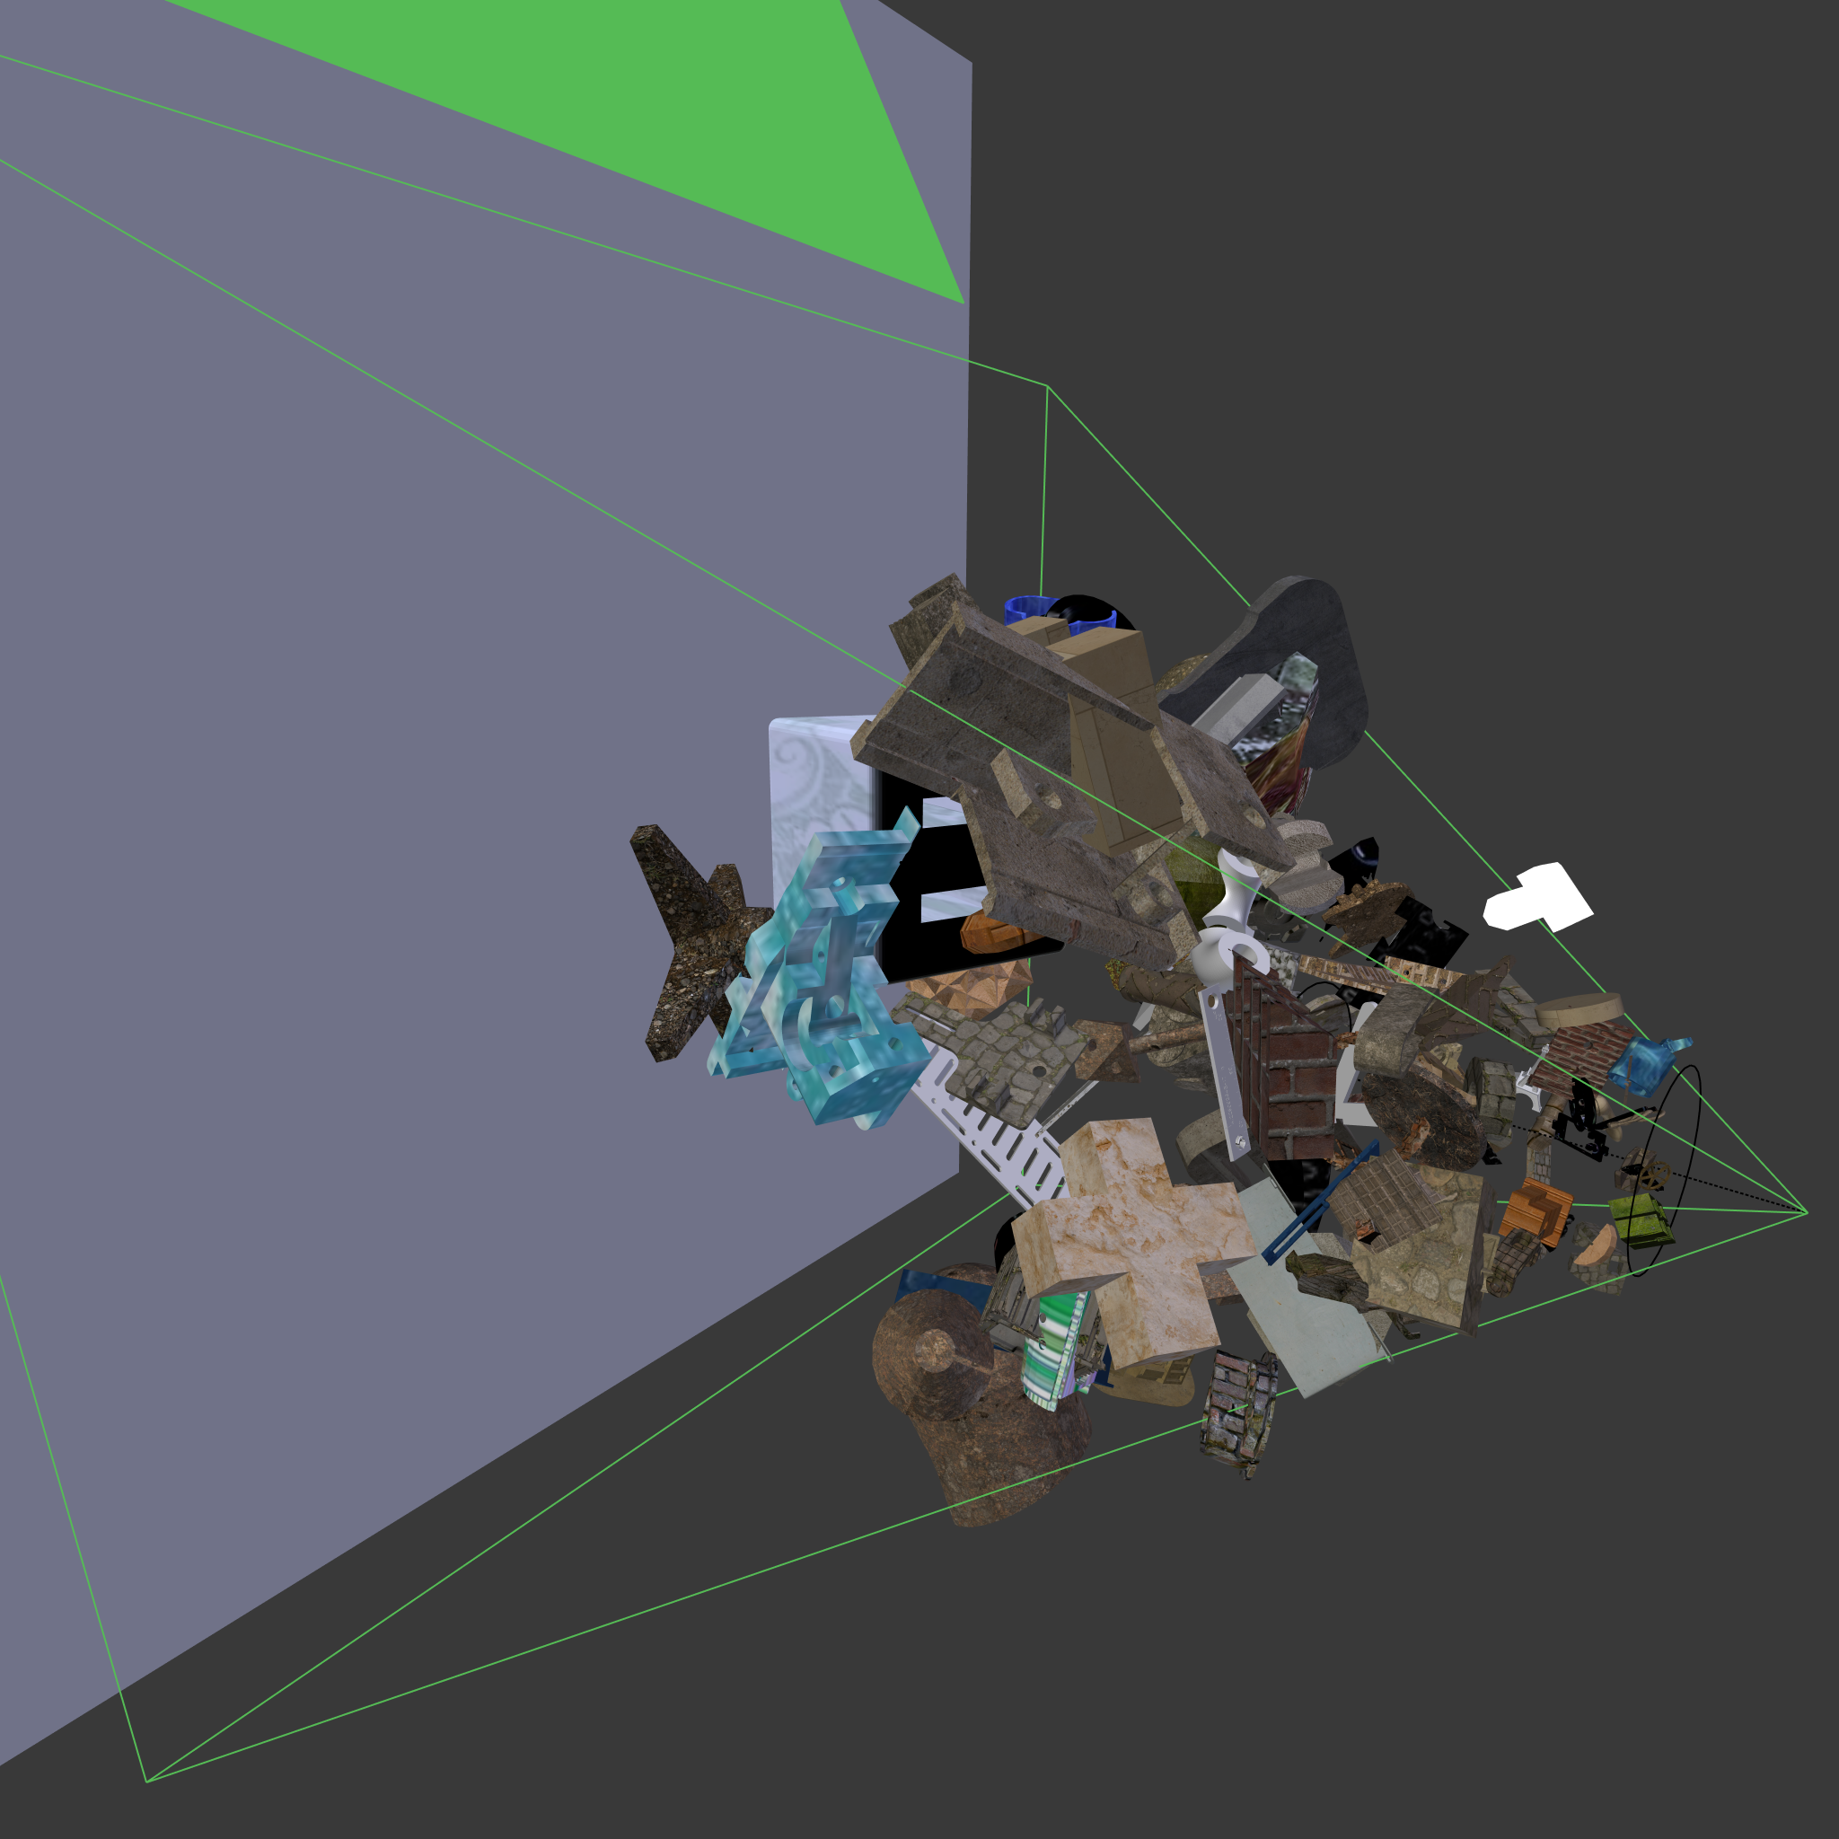
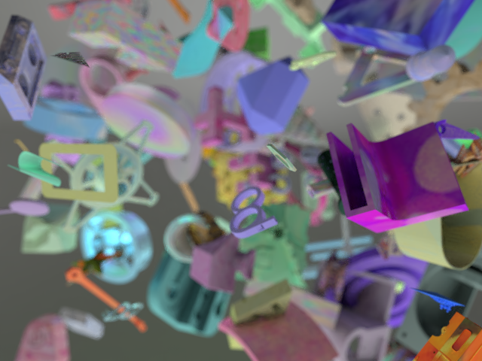
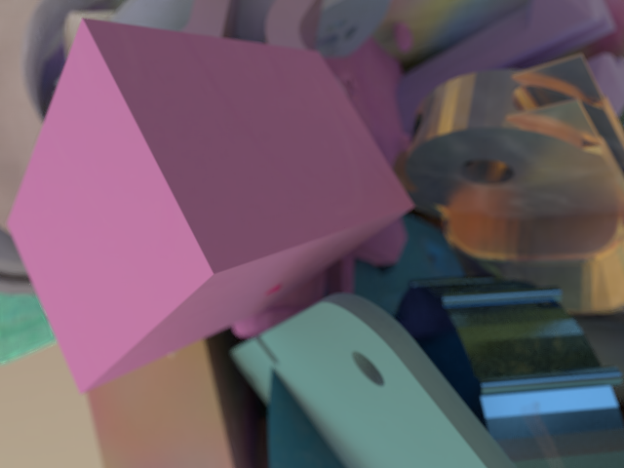

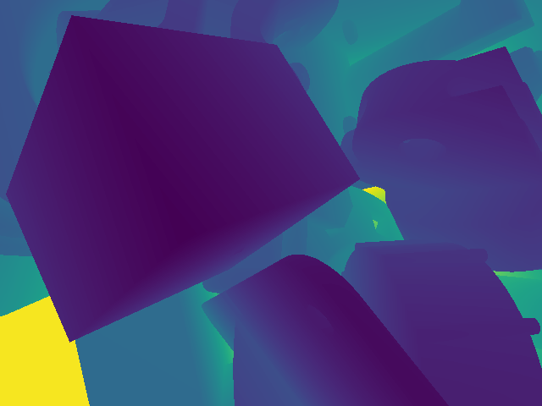
Synthetic Dataset
Blender scene
Small obj data
Large obj data
Notes:
Here you can see how one random example scene looked like in the Blender editor. Finally we created two different training sets to represent different aspects of the real world. One of them only contains small and highly textured objects. The other one has larger and more untextured objects to also account for big surfaces like tables or floors which appear in real-world scenarios. On the slide you can see one example of each with its respective ground truth generated by Blender.

Slide 16
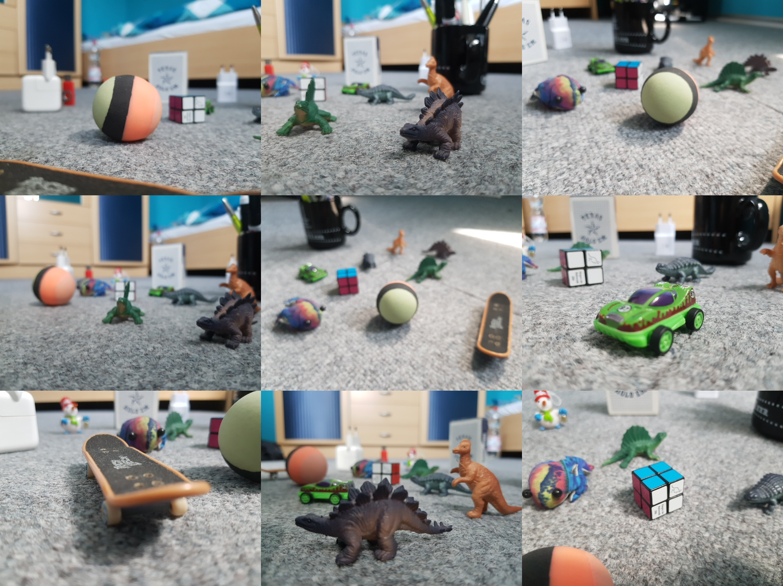
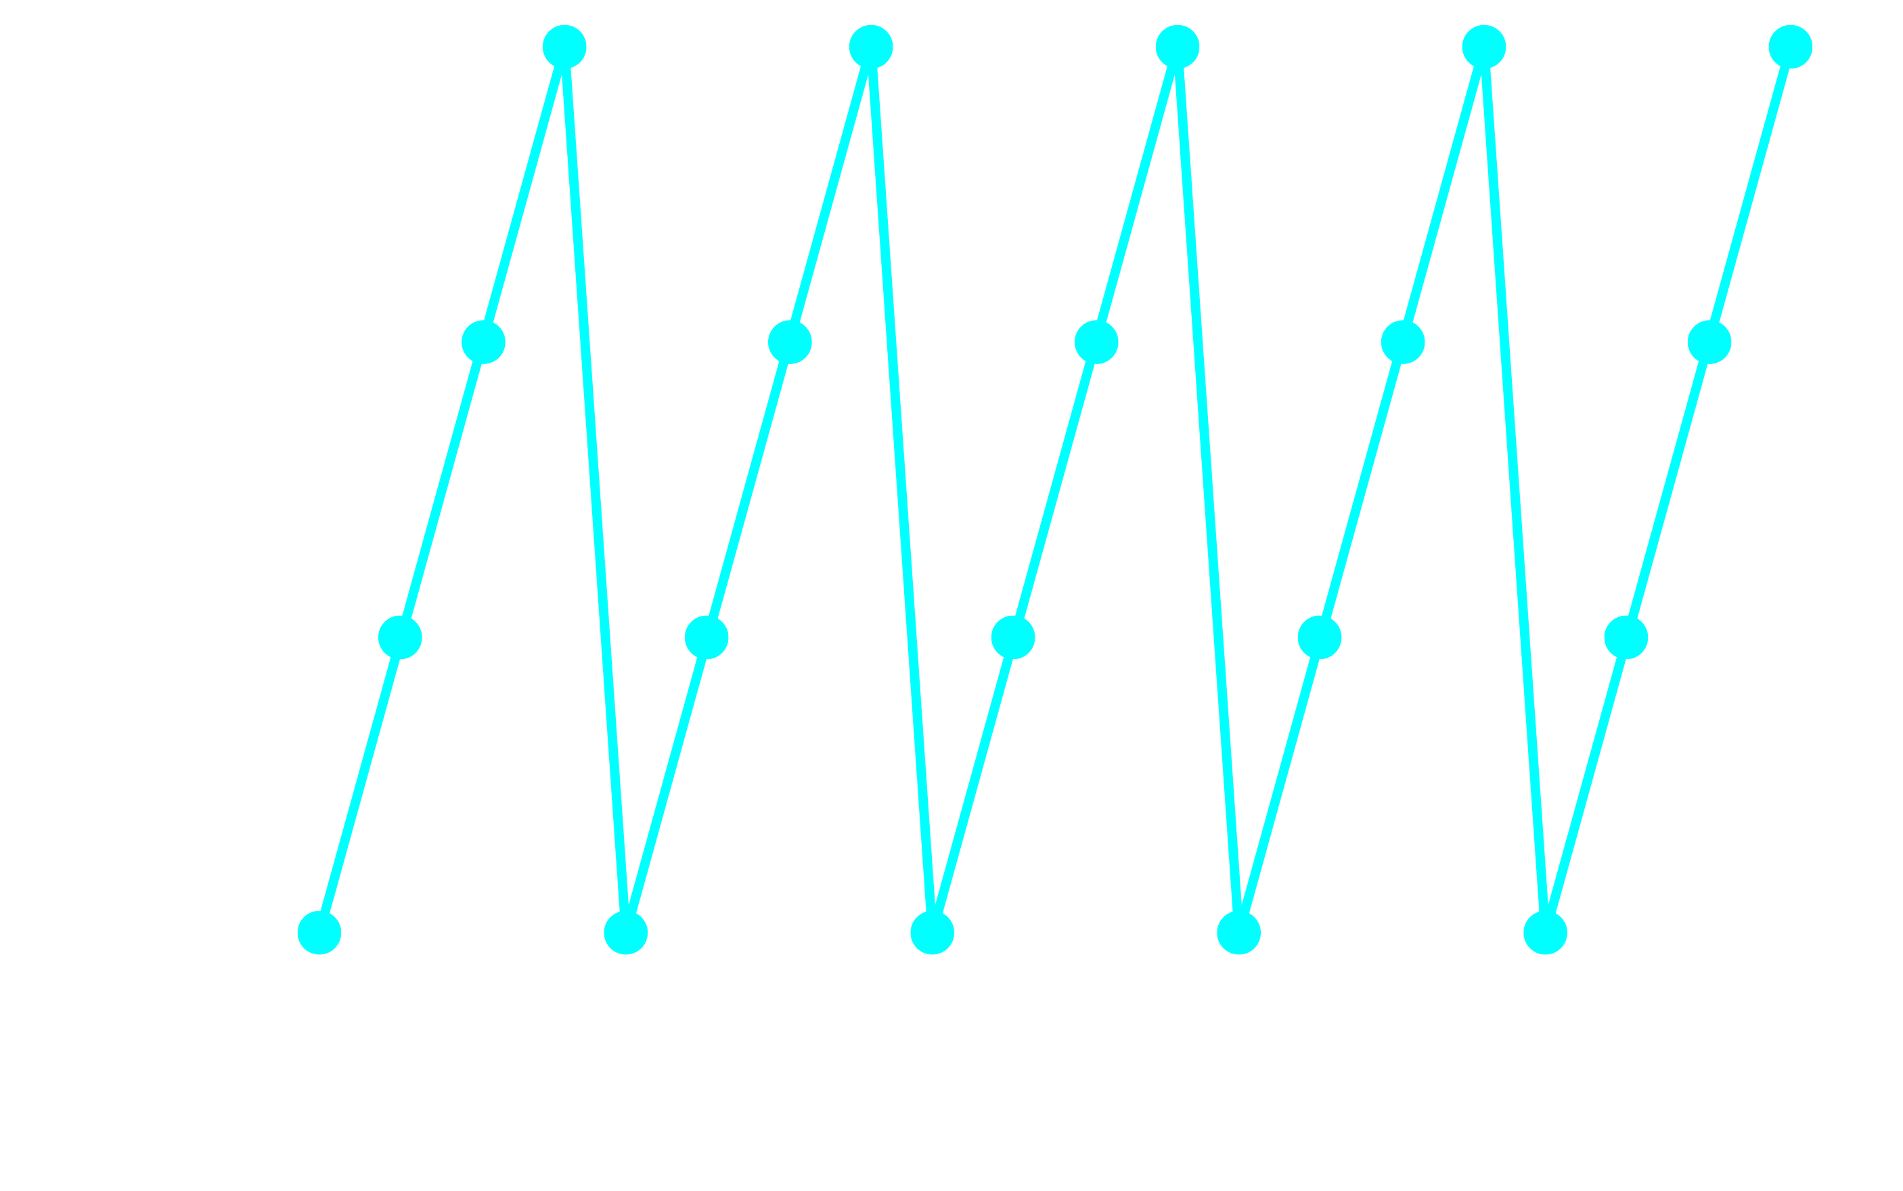
Real-World Dataset: Test Set (Unlabeled)
Carpet dataset
Fast camera motion
Notes:
5 focus stacks of 4 frames, predict depth after each completion of on focus stack at the peaks.
We increased the distance to a certain maximum and then restart again from the beginning
Blender synthetic data uses same focus sweeping

Slide 17
Training
Using synthetic training set
Train loss: MSE
Masked loss to exclude wall
Input: One focus stack of 4 frames with increasing focus distances
256 x 256 random crops
Notes:
Now we are finally ready to train our CNNs. For training we will use the simple MSE loss. However we will mask out pixels which lie on the plain back wall in the blender dataset since this is not the case in real world scenarios. We will provide one focus ramp to the networks consisting of four frames. The color images will thereby be cropped to the resolution 256x256. For augmentation we will randomly horizontally flip the input. We also reserve a part of the traing set for validation. We have two training sets one with small and one with large objects but will initially only train on the small object dataset.

Slide 18
Synthetic Blender Test Set Metrics
Model | MSE | RMS | Accuracy
DDFF Small Obj | 1.8 × 10⁻³ | 0.041 | 86.78
LSTM-DDFF Small Obj | 1.1 × 10⁻³ | 0.033 | 94.98
Recurrent AE Small Obj | 3.4 × 10⁻³ | 0.058 | 69.02
Recurrent AE Small & Large Obj | 3.2 × 10⁻³ | 0.056 | 70.77
Notes:
With blender -> perfect depth ground truth

Slide 19
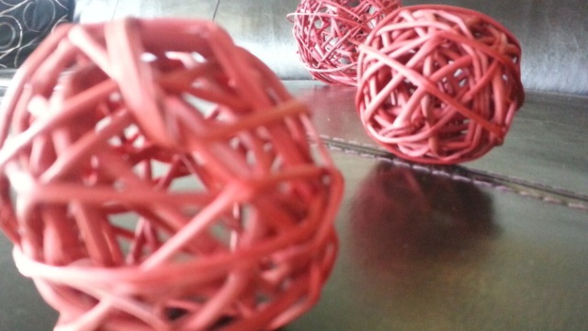
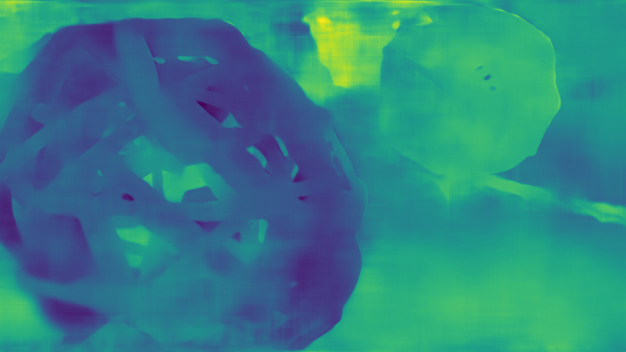
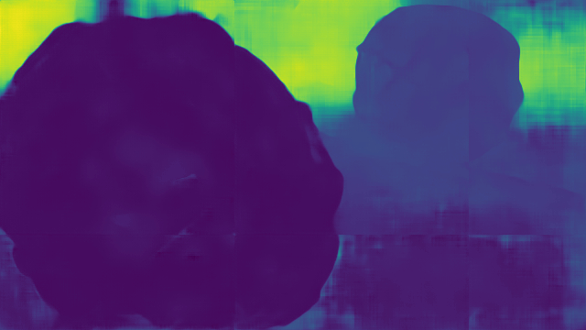
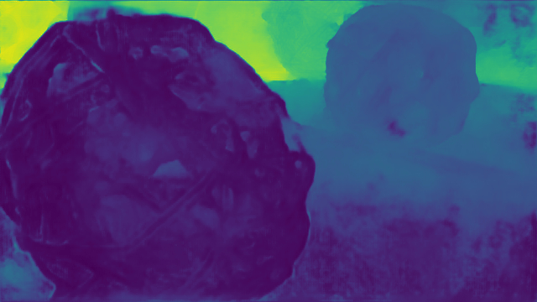
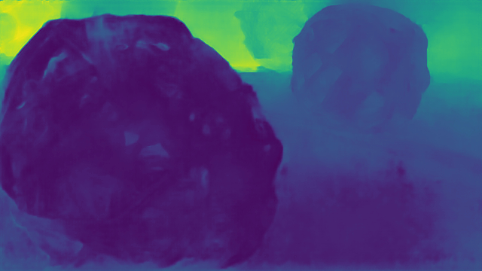

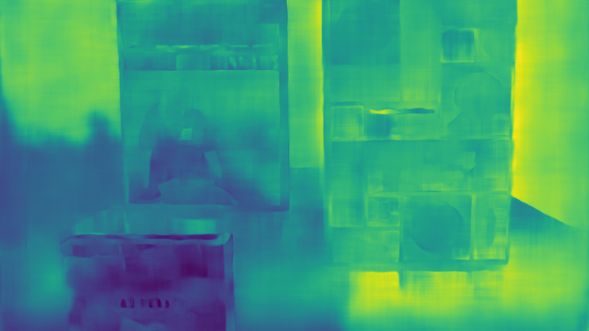
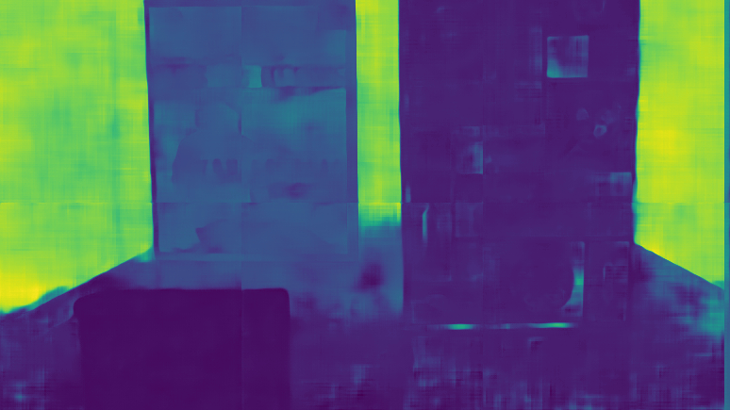
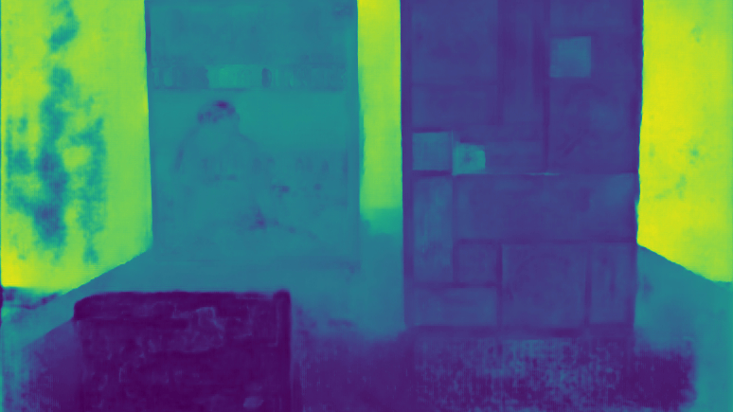
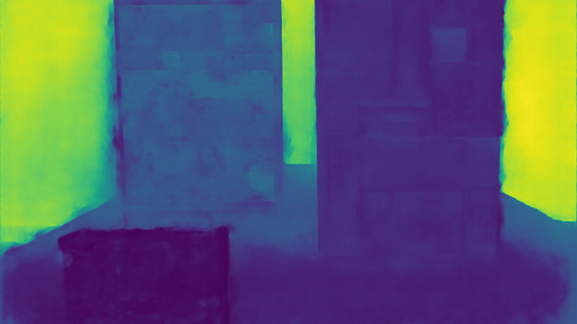
Results Static (Suwajanakorn)
DDFF
Small Obj
LSTM-DDFF
Small Obj
Recurrent AE
Small Obj
Recurrent AE
Small & Large
Input
Notes:
Explain colormap and suwajanakorn data its static focus stack and unlabeled

Slide 20
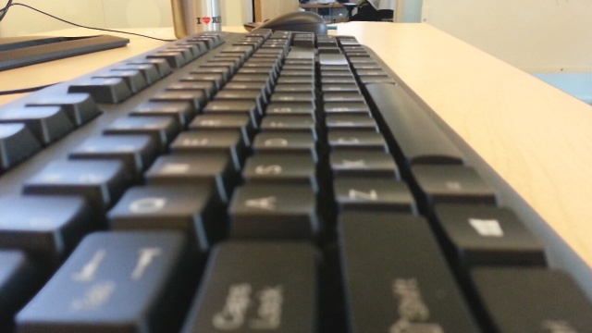
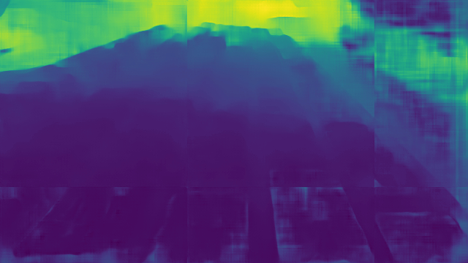
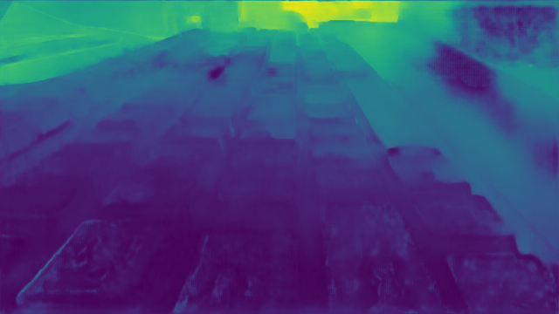
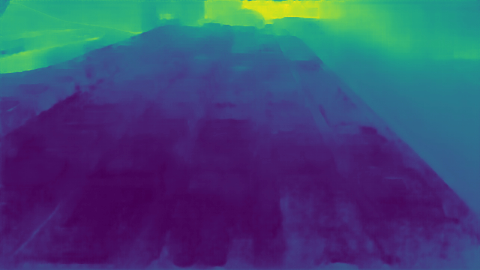
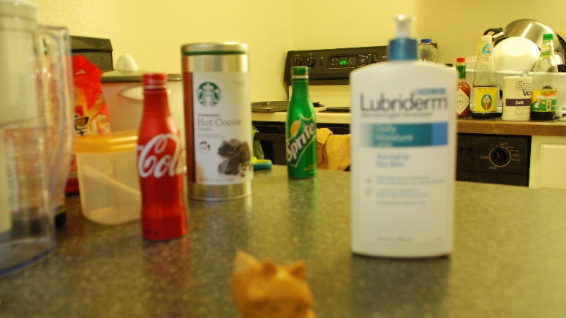
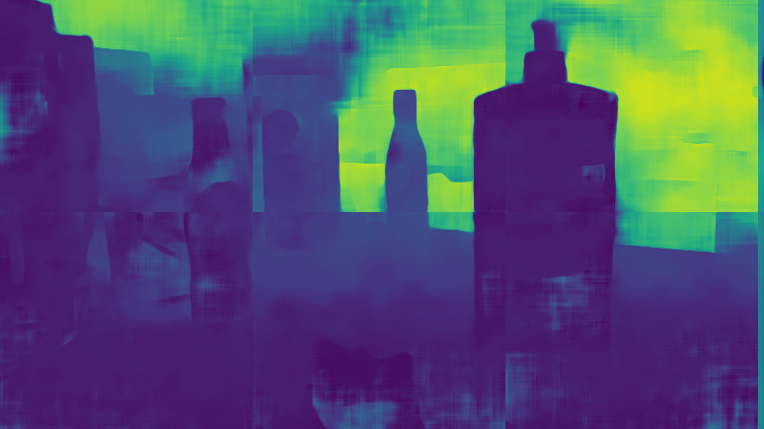
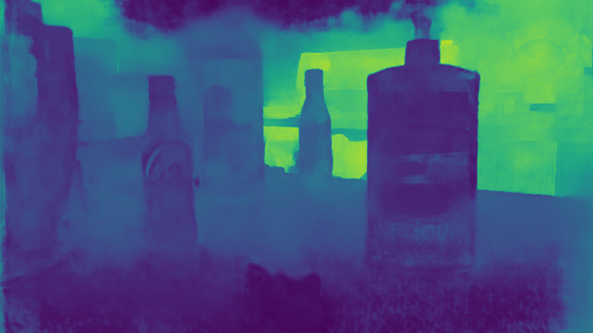
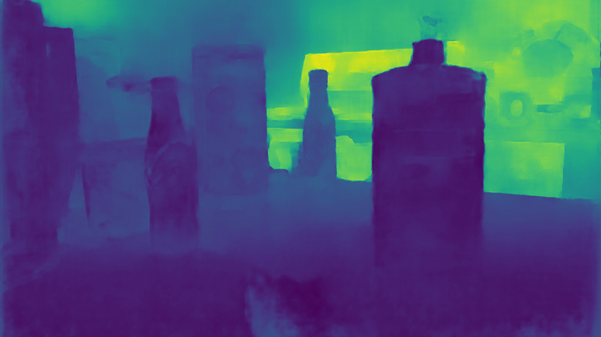
Results Static (Suwajanakorn)
LSTM-DDFF
Small Obj
Recurrent AE
Small Obj
Recurrent AE
Small & Large Obj
Input
Notes:
Testing on other samples from the Suwajanakorn set shows again that the recurrent autoencoder produces more smooth results with the one incorporating the larger dataset as best version.

Slide 21
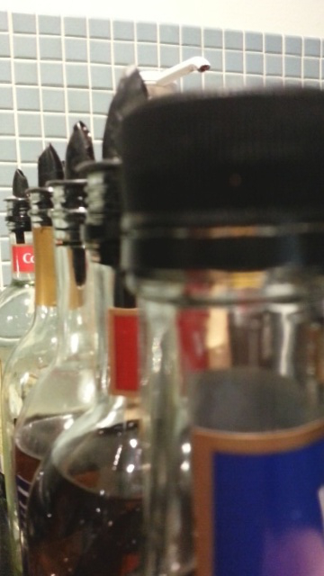
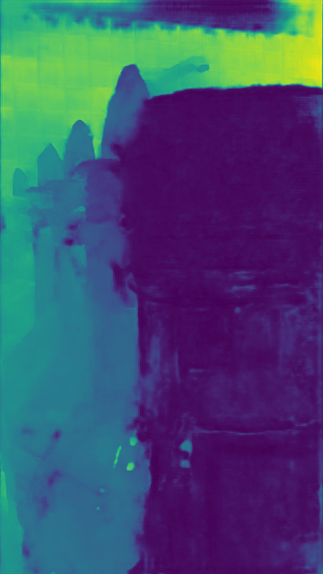
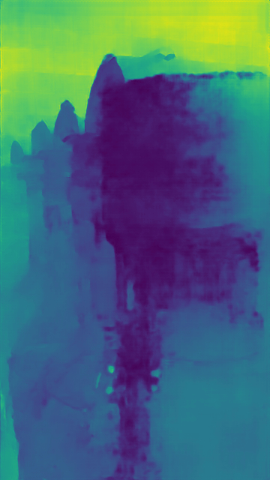
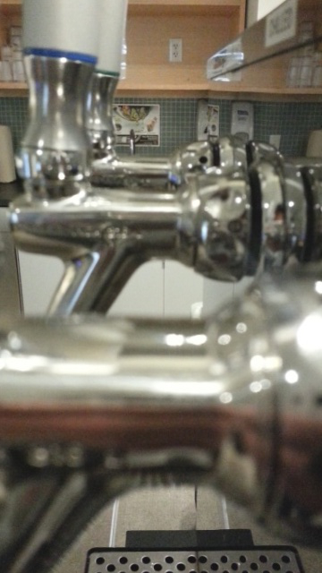
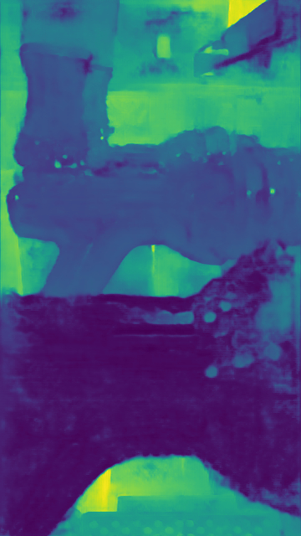
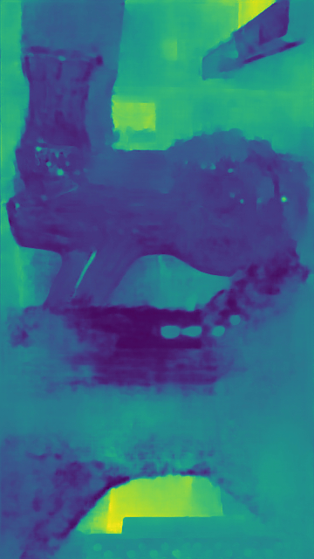
Results Static (Suwajanakorn): Recurrent Autoencoder
Small & Large Obj
Small & Large Obj
Input
Small Obj
Input
Small Obj
Notes:
Focusing more on the recurrent autoencoder we can see that even for transparent and reflecting objects, plausbile depth maps are returned. In this case the small obj only version seems superior considering the near part.

Slide 22
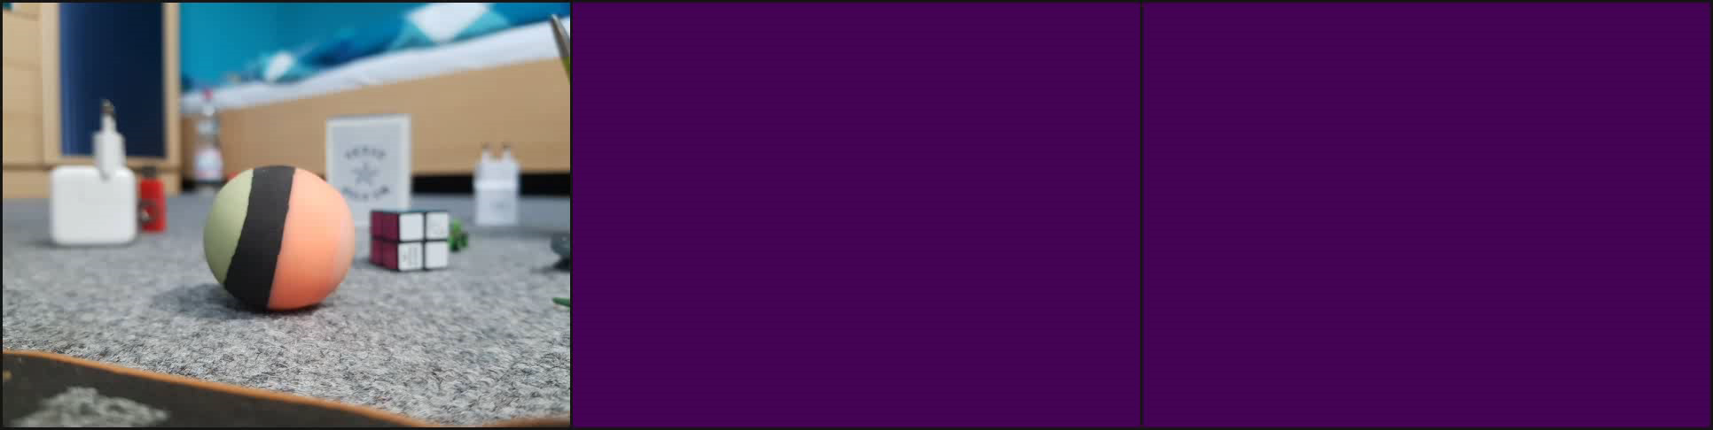
Results Dynamic (Carpet): Recurrent Autoencoder
Recurrent AE
Small Obj
Recurrent AE
Small & Large Obj
Input
Notes:
One final test shows the consistency of the depth output from the recurrent autoencoders. We are using the carpet dataset here. You can see in the video that there is quite a lot of movement happening between the frames. Every time a focus sweep is finished a depth prediction is produced.

Slide 23
Discussion
Proposed architectures show good real-world generalization
Synthetic test metrics and real-world performance differs
Recurrent autoencoder produces best results even in challenging scenarios
LSTM-DDFF produces seams
DDFF does not generalize
Larger data sometimes gives improvement
Notes:
Discussing our results we find that the recurrent autoencoder produces the best results among our architectures. The LSTM-DDFF Stack Cat-Conv also returns good results but since only a fixed resolution can be input because of the contained LSTM there are visible seams in the output. CoC supervision seems to not provide any benefit for the prediction quality. Larger data on the other hand sometimes improves the result but sometimes performs worse. Generally we also notice that a good test loss does not result in good real-world performance.

Slide 24
Limitations
No best configuration
Depth from focus issues with
Reflections
Transparency
Uniform coloring
No confidence for predictions
Notes:
The limitations of our work are that it was not possible in the end to find the best version of the recurrent autoencoder. Also there are the general depth from focus issues which are causing problems in the predictions such as reflections, transparency and uniform coloring. Also there is no confidence provided by our models which says how sure the model is about a certain pixel prediction.

Slide 25
Conclusion
Modified recurrent AE as a simple and lightweight depth estimator
Real-world dataset hard to acquire
Training on synthetic dataset is superior
Future directions
Optimize training data and recurrent autoencoder
Recurrent AE interesting for structure from motion
Combine with CoC for superior depth prediction
Notes:
Concluding our work we presented the recurrent AE, which is a simple and lightweight way to predict depth from videos. Additionally we recorded labeled real world data which was to inefficient in the end. We therefore showed how to create a synthetic training set efficiently which nevertheless leads to good real-world generalization. For future research we would like to investigate more in perfecting the training data and the recurrent AE as it to find one best depth predictor. Also we think that its resistentness to movement makes the recurrent AE also a good choice for structure from motion. In the end one could combine depth from focus and structure from motion to develop a superior depth prediction system.

Slide 26
The End
Notes:
Concluding our work we presented the recurrent AE, which is a simple and lightweight way to predict depth from videos. Additionally we recorded labeled real world data which was to inefficient in the end. We therefore showed how to create a synthetic training set efficiently which nevertheless leads to good real-world generalization. For future research we would like to investigate more in perfecting the training data and the recurrent AE as it to find one best depth predictor. Also we think that its resistentness to movement makes the recurrent AE also a good choice for structure from motion. In the end one could combine depth from focus and structure from motion to develop a superior depth prediction system.

Slide 27
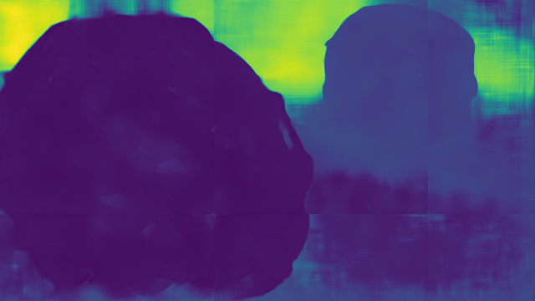
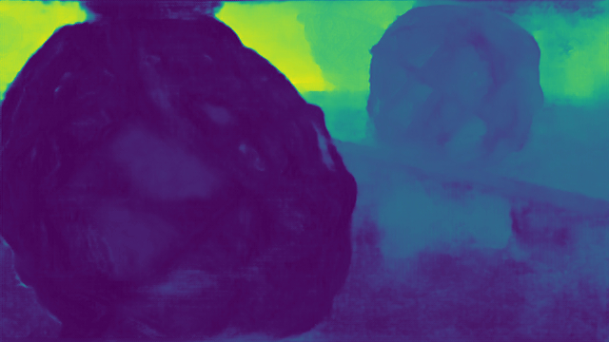
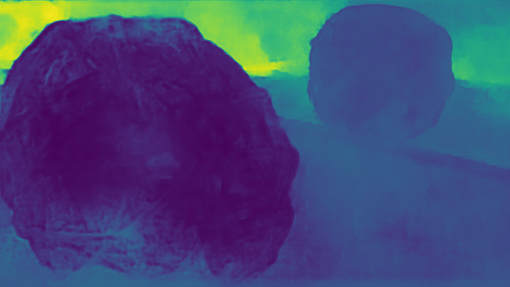
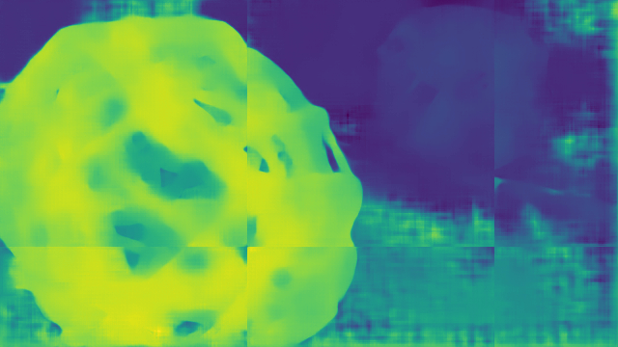
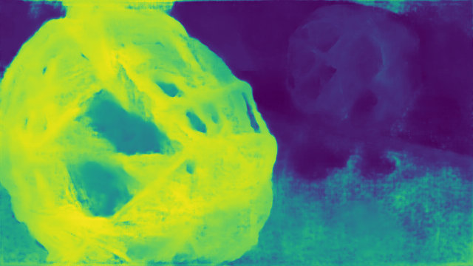
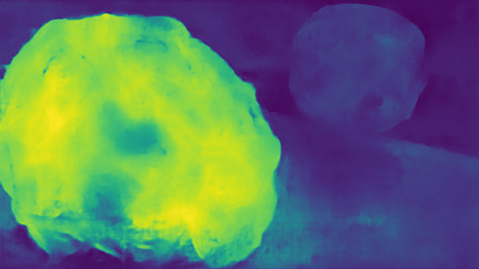
Results Static (Suwajanakorn): CoC Supervision
LSTM-DDFF
Small Obj
Recurrent AE
Small Obj
Recurrent AE
Small & Large Obj
Input
Notes:
Tests considering the CoC supervision show that the supervision itself does not seem to change the outcome that much. Even though the predicted CoC map which is represented by the bottom line looks very plausible.

Slide 28
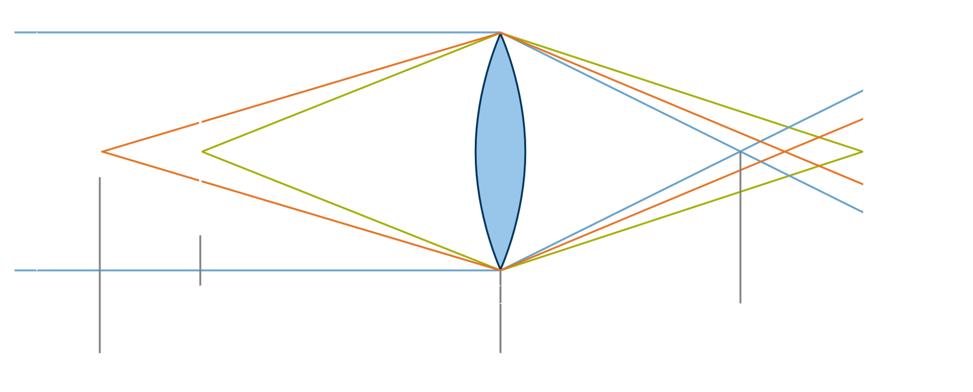

Circle of Confusion (CoC)
$$c=\frac{Af\left|D−F\right|}{D(F−f)}$$
Notes:
Now lets take a closer look on how the defocus of one object is actually related to its depth. Here you can see a simple model of a lens. A point in the real world appears as point on the final image on the sensor if it is in perfect focus. Otherwise the point will blur out to a circle. The diameter of this circle is thereby called the Circle of Confusion or CoC. It is a measure for the amount of defocus. Points in the scene that are exactly the focus distance apart from the lens appear in perfect focus. The plane containing those points is thereby called the focal plane. All other points will blur based on how far they are awaz from the focal plane. The point on the object here behind the focal plane will leave the CoC based on the orange light rays. Left to the figure you can see the exact equation of the CoC. Meaning in the end if we can estimate the CoC c which is visible in the frames of the focus stack it is possible to make assumptions about the depth D.

Slide 29
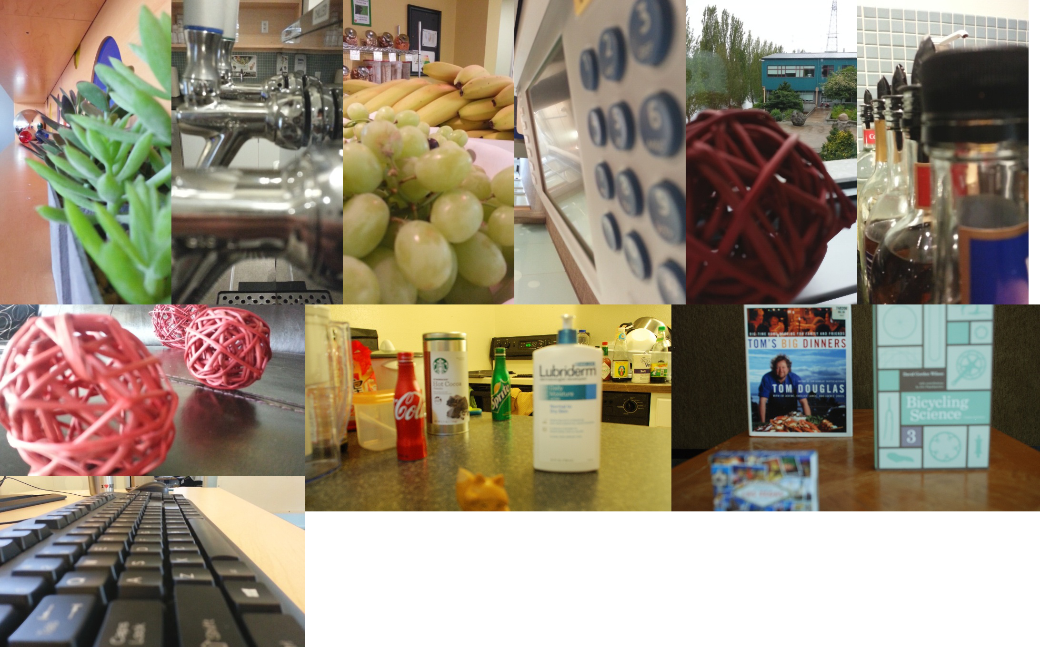
Related Work: Depth from Focus (Suwajanakorn et. al)
Variational approach for static focus stacks
Perfectly static dataset
Notes:
Another work is done by Suwajanakorn which also use varional methods for predicting from a perfect static focus stack. We are going to use their dataset for testing since it is perfectly static to see how our model behaves in a first instance in the absence of movement.

Slide 30
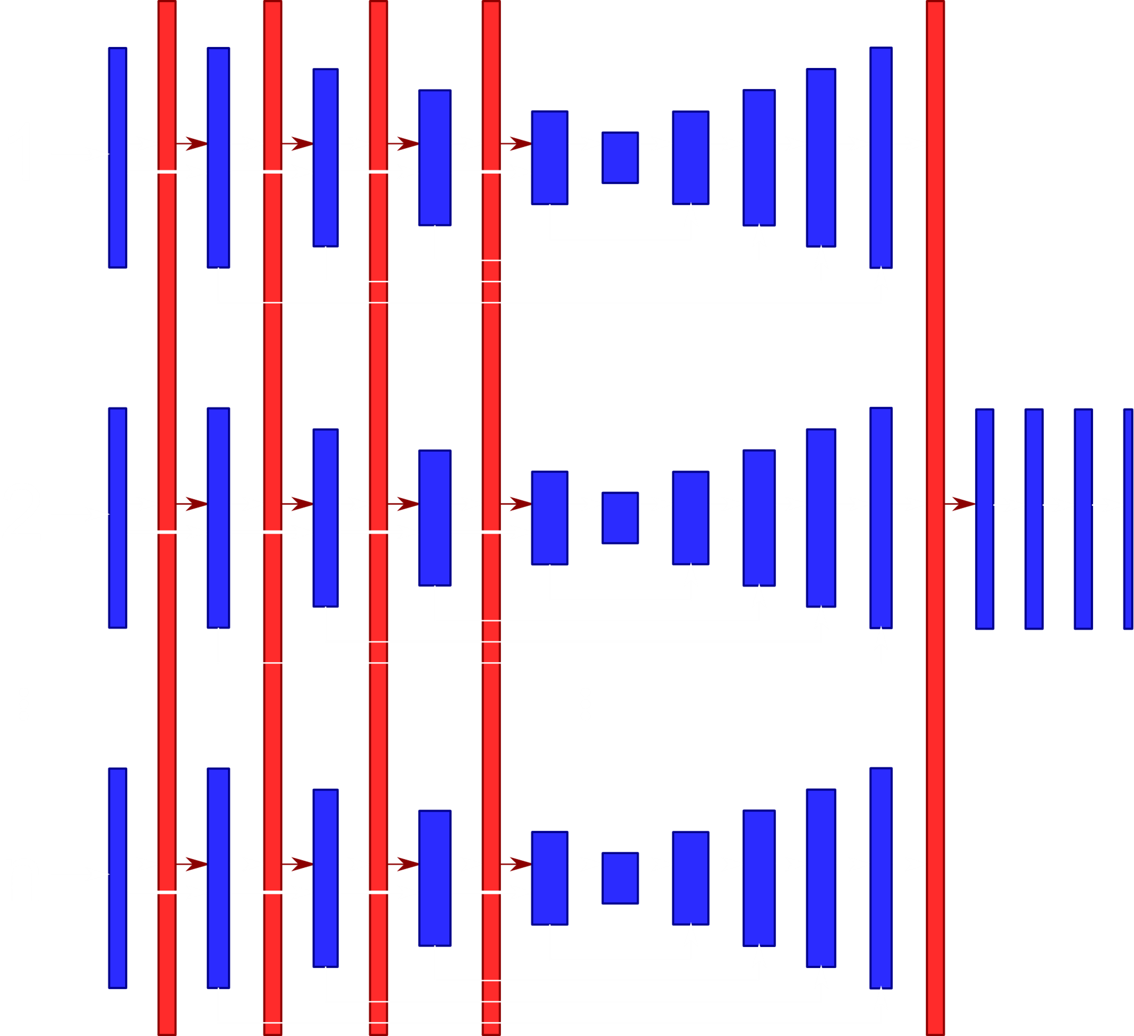
Related Work: Burst Image Deblurring (Aittala et. al)
Permutation Invariant CNN
Encoder-Decoder
Sequence input
Order invariant
Global max-pool layers for information exchange
Notes:
Leaving last pool laz

Slide 31

Related Work: Burst Image Deblurring (Aittala et. al) - Global Max-Pooling
Notes:
Taking a closer look on those Global max-pooling layers we can see a network using to input streams. Consider x1 and x2 are thereby output from two regular layers (like a convolution) from both streams. These are then forward to the next layers as well as to a commom global max pool layer. This global max pool layer inputs all feature maps and calculates the maximum out of them. These are then also forwarded as additional information to the next layer. As a consequence information is exchanged every global max pool layer. Since the maximum function is commutative the output of the CNN does not depend on the input order.

Slide 32

Related Work: Interactive Reconstruction (Chaitanya et al.) - Recurrent Block
Notes:
Here you can see a recurrent block in detail. The output from one layer for the previous input n-1 is stored and reused when processing the current input n in form of concatenitation. The recurrent autoencoder thereby has a memory of the previous input while being fully convolutional.

Slide 33
LSTM-DDFF
DDFF lacks sequential understanding
Use LSTM
Recurrent Module
Flattening and dimension reduction
LSTM
Skip connection aggregation
Last encoder only
Convolution
Notes:
The LSTM-DDFF builds on the fact that the original DDFF lacks proper sequential understanding. Thus we want to extend it with an LSTM which we insert in the form of a recurrent module in between the encoder and the decoder. Besides the LSTM the recurrent module also performs flattening and dimension reduction to suit the LSTM. The encoding from each input thereby gets successively fed to the recurrent module whereas only for the last input the decoder is applied.
We also have to treat the skip connections since there are multiple encoder applications but only one decoder. For that we either only consider the output of the last encoder or take the input from all encoders and score it using a 1x1 convoluion.

Slide 34


LSTM-DDFF: Recurrent Module Types
Fully connected
Flatten C x H x W
Large LSTM dimension
Stacking
Flatten H x W
Long sequence
Double layered LSTM
Notes:
We actually propose two different kinds of recurrent modules. The first one uses fully connected layers. It inputs the 3D feature maps from the encoding and flattens them to 1D vector. An additional fully connected layer is then used to further reduce the dimesion to 2048 in this case. After that the result is forwarded to the LSTM on which output the operations are finally reversed.
The second way we'll refer to as stacking. Here only the height and width dimensions are flattened and stacked to very long sequence. We then use a double layered small dimension LSTM to process. This method does not need fully connected layers.

Slide 35
PoolNet
Modification of the Permutation Invariant CNN
Batch Normalization
Less feature channels
No global pooling in the decoder
Variations
Giving focus distance as channel for each frame
Two PoolNets in sequence
Predict CoC maps first for all inputs (leave out last pooling)
Then predict depth using predicted CoC
Notes:
The second architecture is the Poolnet which is a modification of the Permutation Invariant CNN. We additionally add batch normalization for more stable training, less feature channels which are pretty a lot in the original and we omit global max pooling layers in the decoder. The idea is that the encoder should already detect the relationship and change of the CoC and store this information in the encoding. We will have several variations of this network. One is to also give the focus distance at which the respective frame was recorded as additional input channel. Another one is to use two PoolNets in sequence whereas the first net should predict the CoC for each pixel for each frame and the second one should use the CoC prediction to make one final depth estimate.

Slide 36

Real-World Dataset: Train Set
Notes:
Here you can see a real world training set we recored using our technique. On the left we can see the first color frame of every sequence and next to it the respective depth which is output by the RGB-D camera. Furthermore the right plot shows the focus distances during the recording time. We notice that we ramped up and down in a periodic way.

Slide 37
Real-World Dataset: Train Set Limitations
CoC hardly noticeable
RGB-D sensor works only for larger distances
Mobile lenses are small and have a large DoF for larger distances
Invalid depth values
Reflections
Occlusions
Time consuming
Notes:
However we discovered several limitation concerning a real-world training set. First of all we were forced to record for larger distances since the Asus Xtion does not work for close objects. However mobile lenses like our smartphone produce very sharp images at far distances making the CoC in the end hardly noticeable
Another point is that there are a lot of missing or invalid depth values in our ground truth which is related to reflections which confuse the RGB-D sensor. Also parts which were occluded from the RGB-D sensor are missing in the ground truth.
The largest issue is that it is very time consuming to record such a dataset. It took several hours to create 20 sequences. We need thousands of thouse for training CNNs in the end.

Slide 38

Synthetic Dataset
5 ramps consisting of 5 frames
No ramp from max to min
Android phone also capable to jump to any focus distance without delay
Notes:
Our synthetic training set contains five ramps per random scene consisting of 5 frames. We decided to not ramp from the maximum to the minimum focus distance anymore so the CNNs do not have to distinguish these two cases. Also we found out that the Android smartphone can do jumps over large focus distances without delay. On the right you can see a plot for the changing focus distances in relation to the current frame number.

Slide 39

Training: Validation Loss
Notes:
Here you can see the validation loss during the training of the networks in their most basic form. We can see that every network converges except the PoolNet. We further experimented with several PoolNet variations but could not achieve convergence in the end so we are not going to perform any further tests on it but focus on our other architectures.

Slide 40

Results Dynamic (Carpet): Recurrent Autoencoder
Recurrent AE
Small Obj
Recurrent AE
Small & Large Obj
Input
Notes:
One final test shows the consistency of the depth output from the recurrent autoencoders. We are using the carpet dataset here. You can see in the video that there is quite a lot of movement happening between the frames. Every time a focus sweep is finished a depth prediction is produced.

